Slide 1

A Tale about Movies
Keshav Kumar Elankovan

Slide 2


About the Dataset
Since we can remember, IMDB has been our go-to resource for learning everything there is to know about movies. We owe our odd taste in movies to IMDB, and we would have missed out on several priceless jewels if not for the website.

Slide 3

ACTOR
Geographic Distribution
Story Board Categories
DIRECTOR
GENRE
IMDb RATINGS
GEOGRAPHIC DISTRIBUTION
Actor

Slide 4

GEOGRAPHIC DISTRIBUTION
The gross collection is the total collection earned by a movie at the tickets all over the theatres without subtracting the entertainment tax. Whereas, the costs in different theatres may vary.

Slide 5
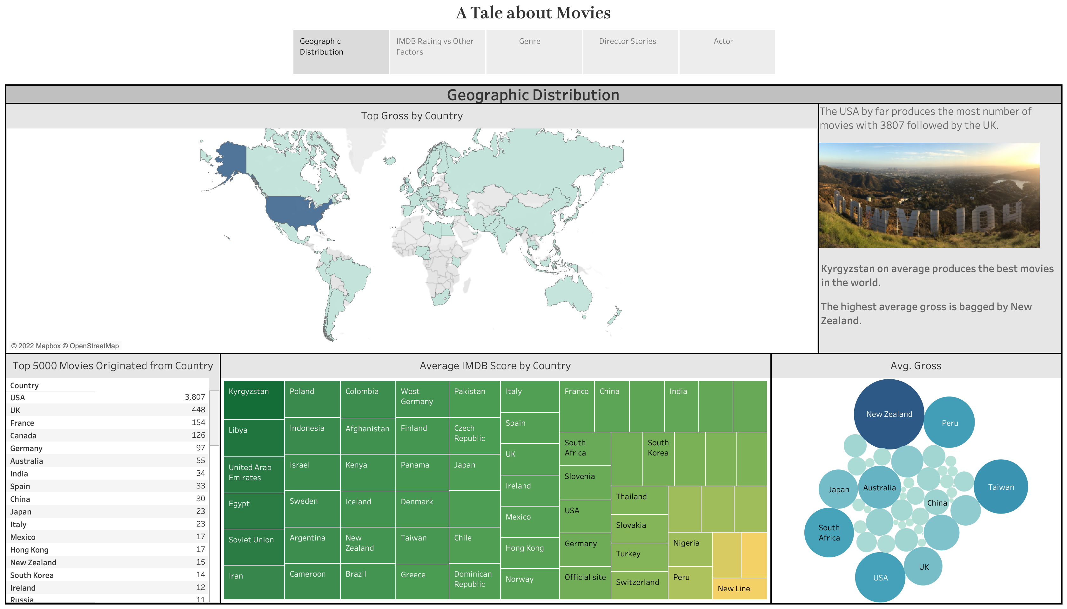

Slide 6
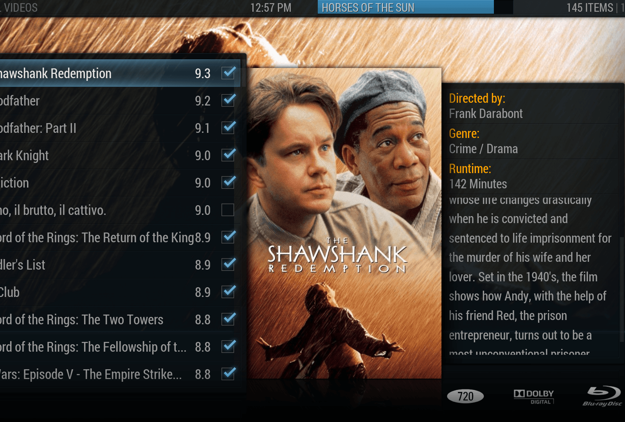

IMDb Ratings
Registered IMDb users have the ability to vote on any film that has been released. Individual votes are then combined and summed into a single IMDb rating, which is likewise based on the IMDb score and is displayed on the title's main page.

Slide 7
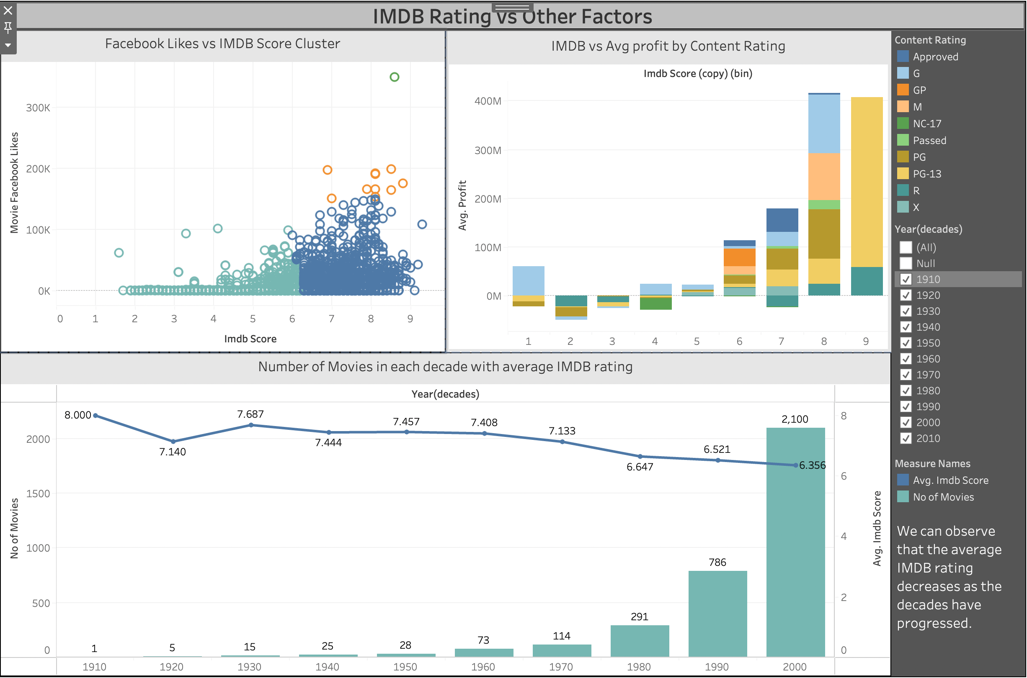

Slide 8

GENRE
G
E
N
R
E

Slide 9
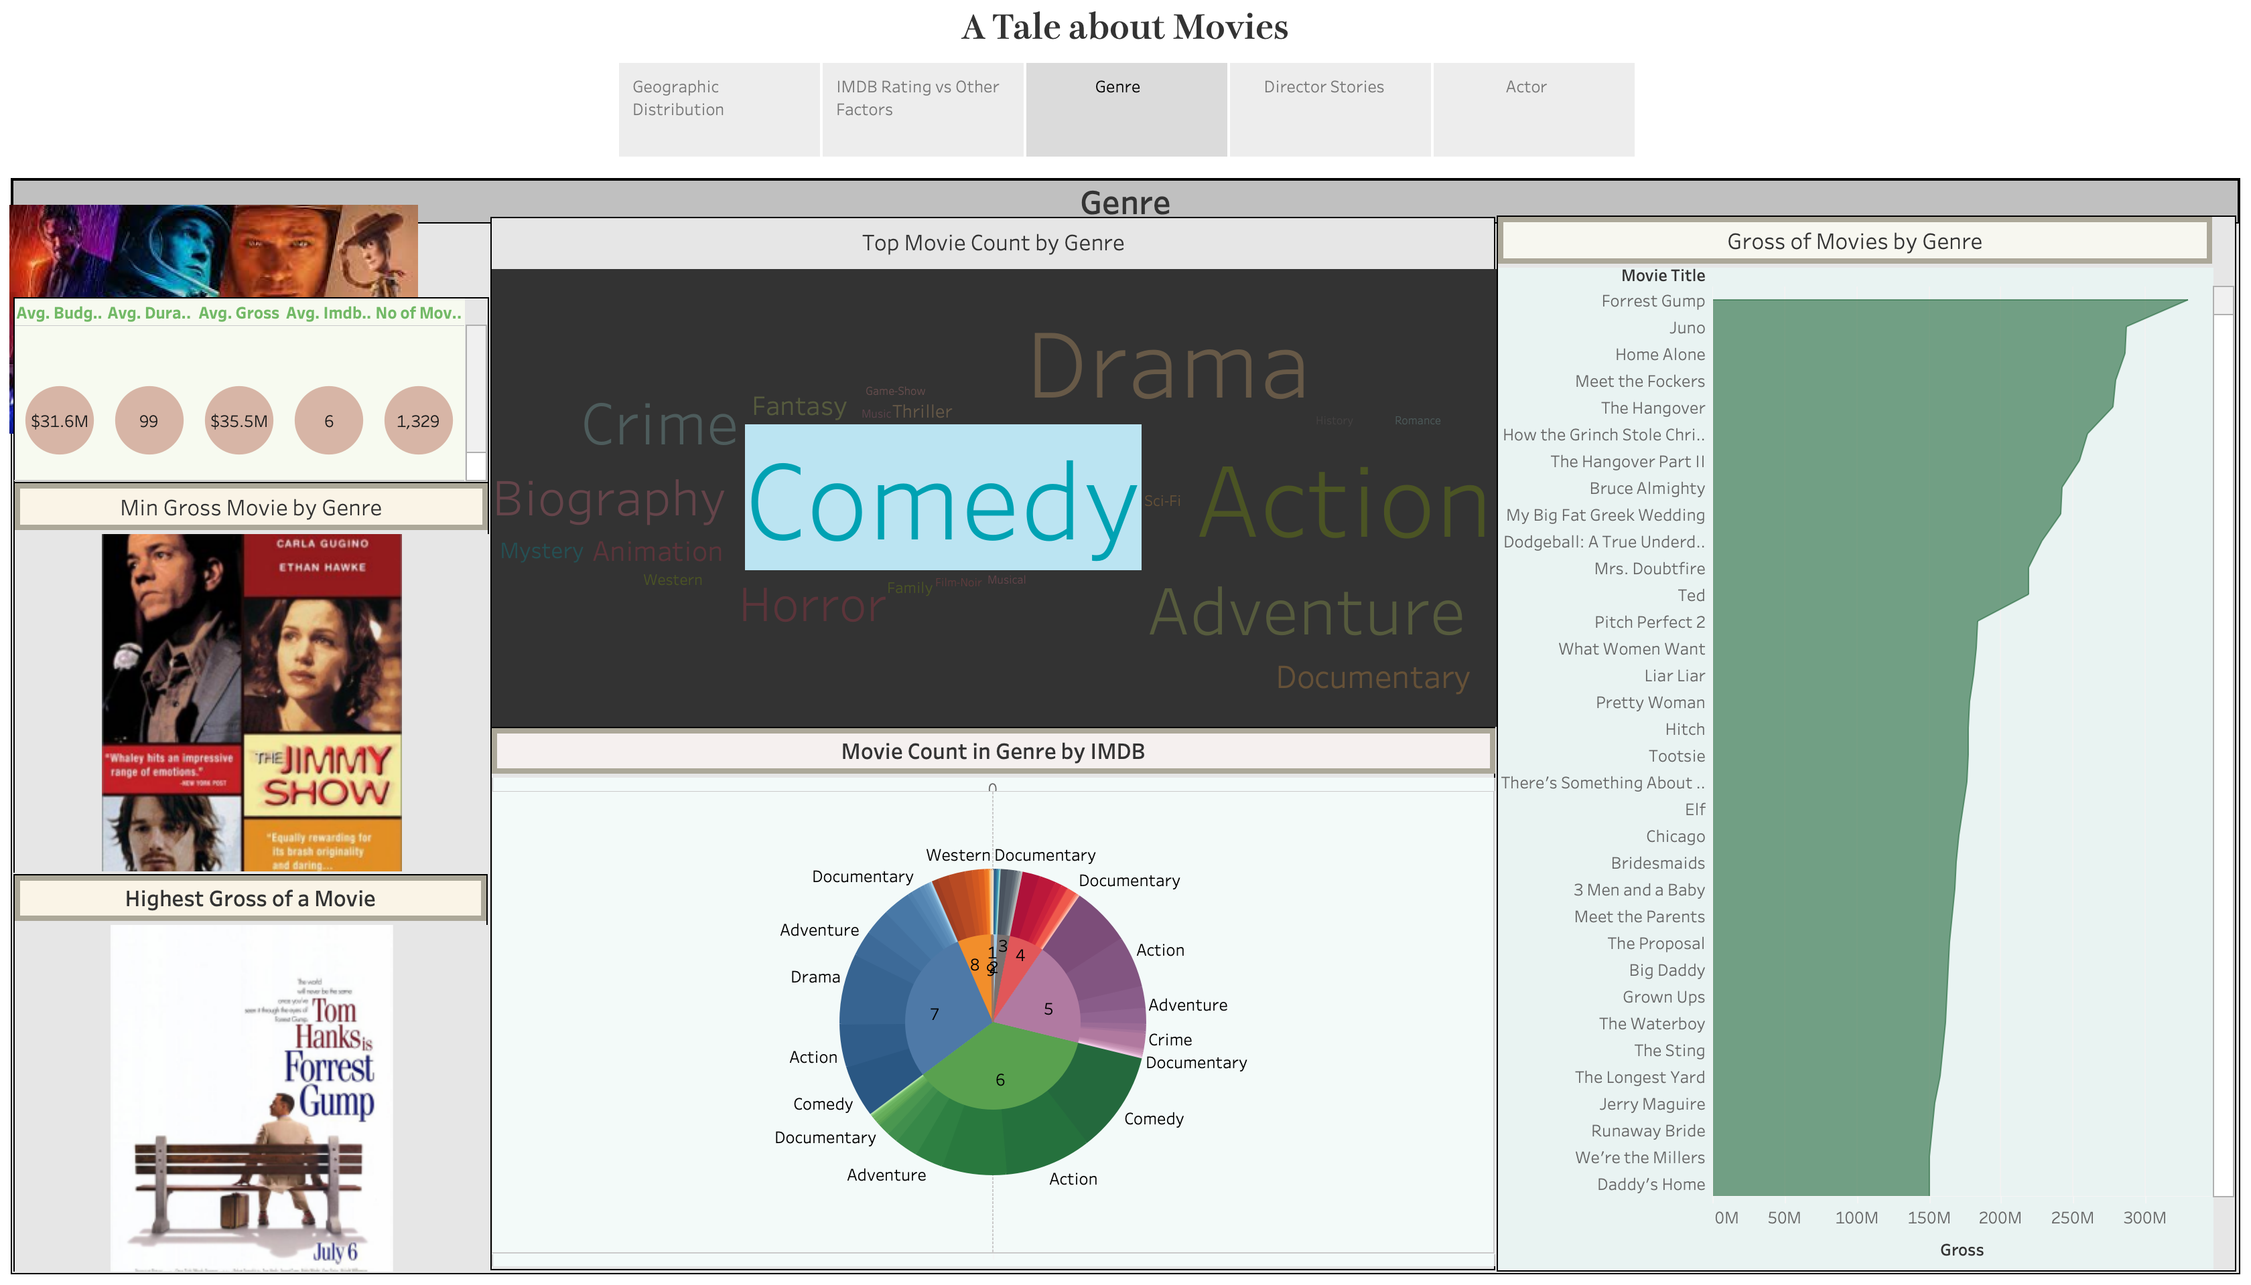

Slide 10


DIRECTOR
Our analysis will then focus on the filmmakers' favorite actors, the length of their films, their gross receipts, and the genres that brought in the most money.

Slide 11
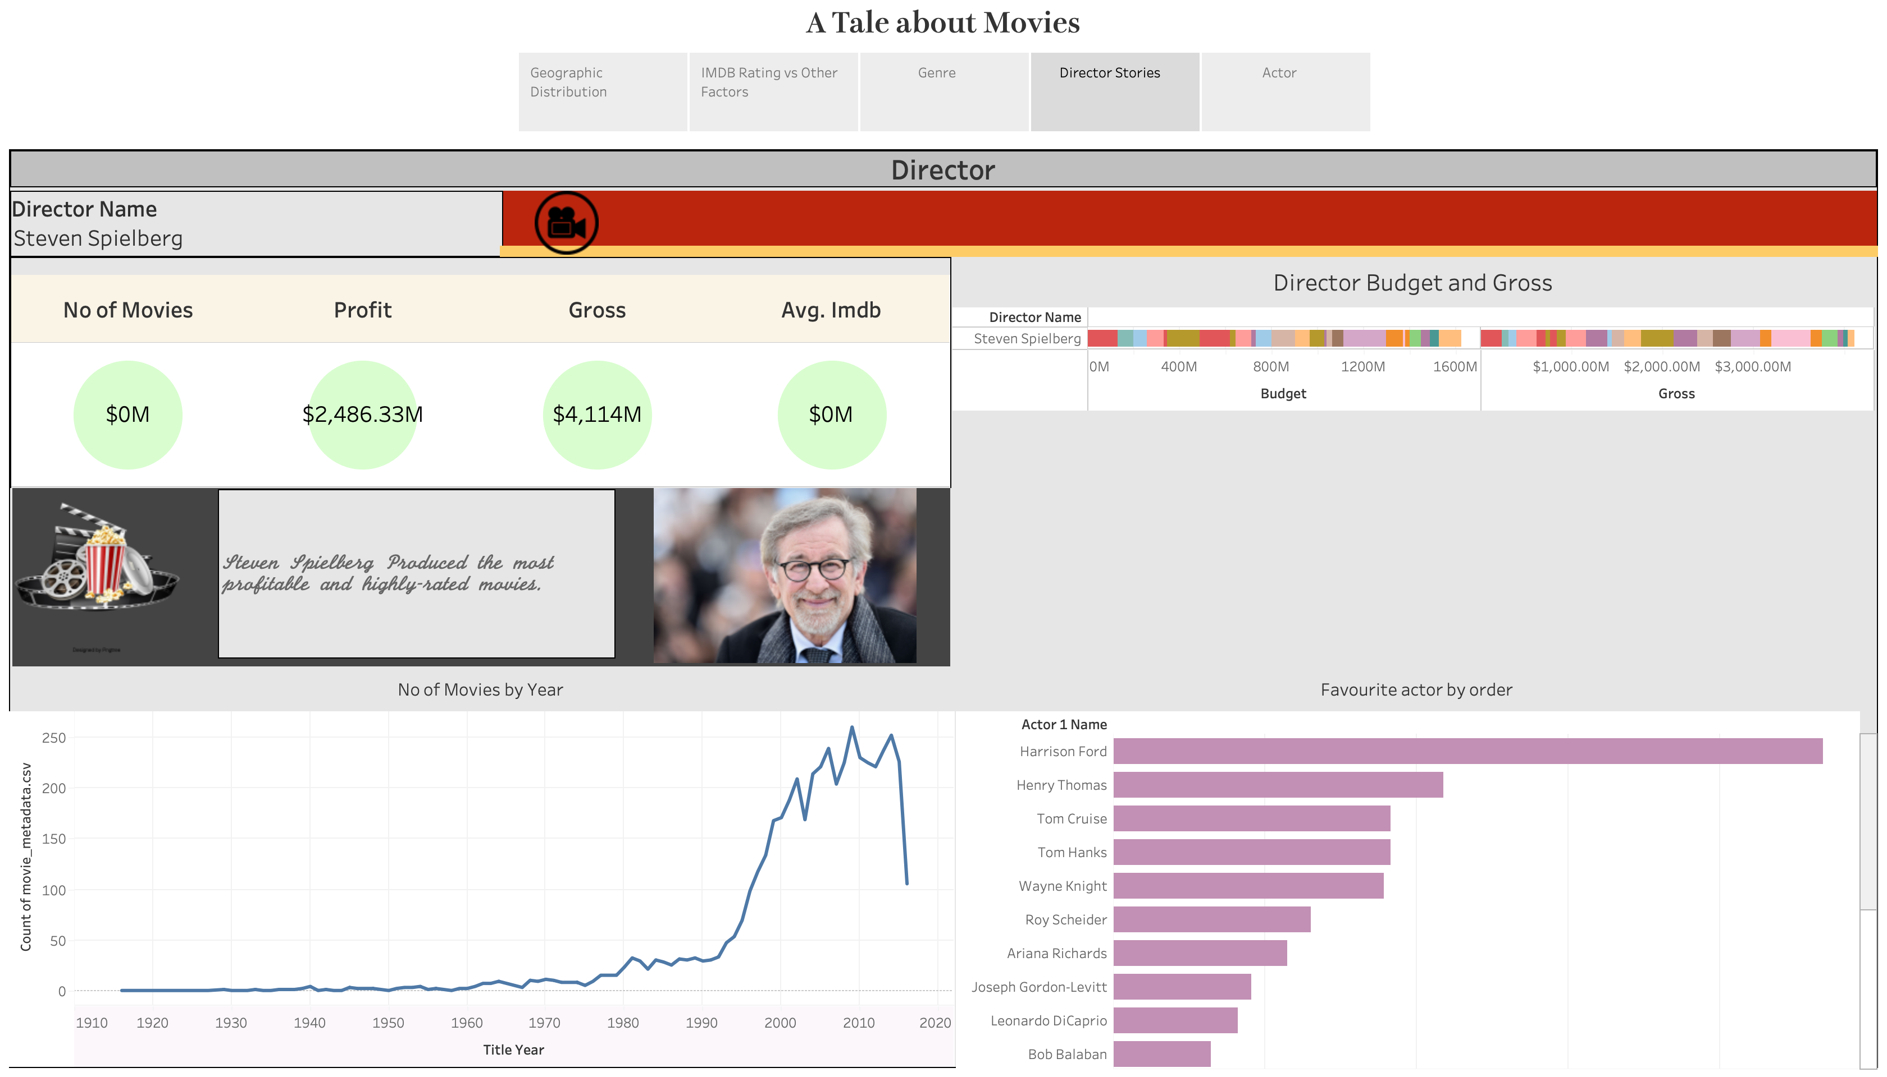

Slide 12

Actor
The actors from around the world, their movies' global distribution, their highest-grossing films, and an overview of the genres are all included in the study that follows.

Slide 13
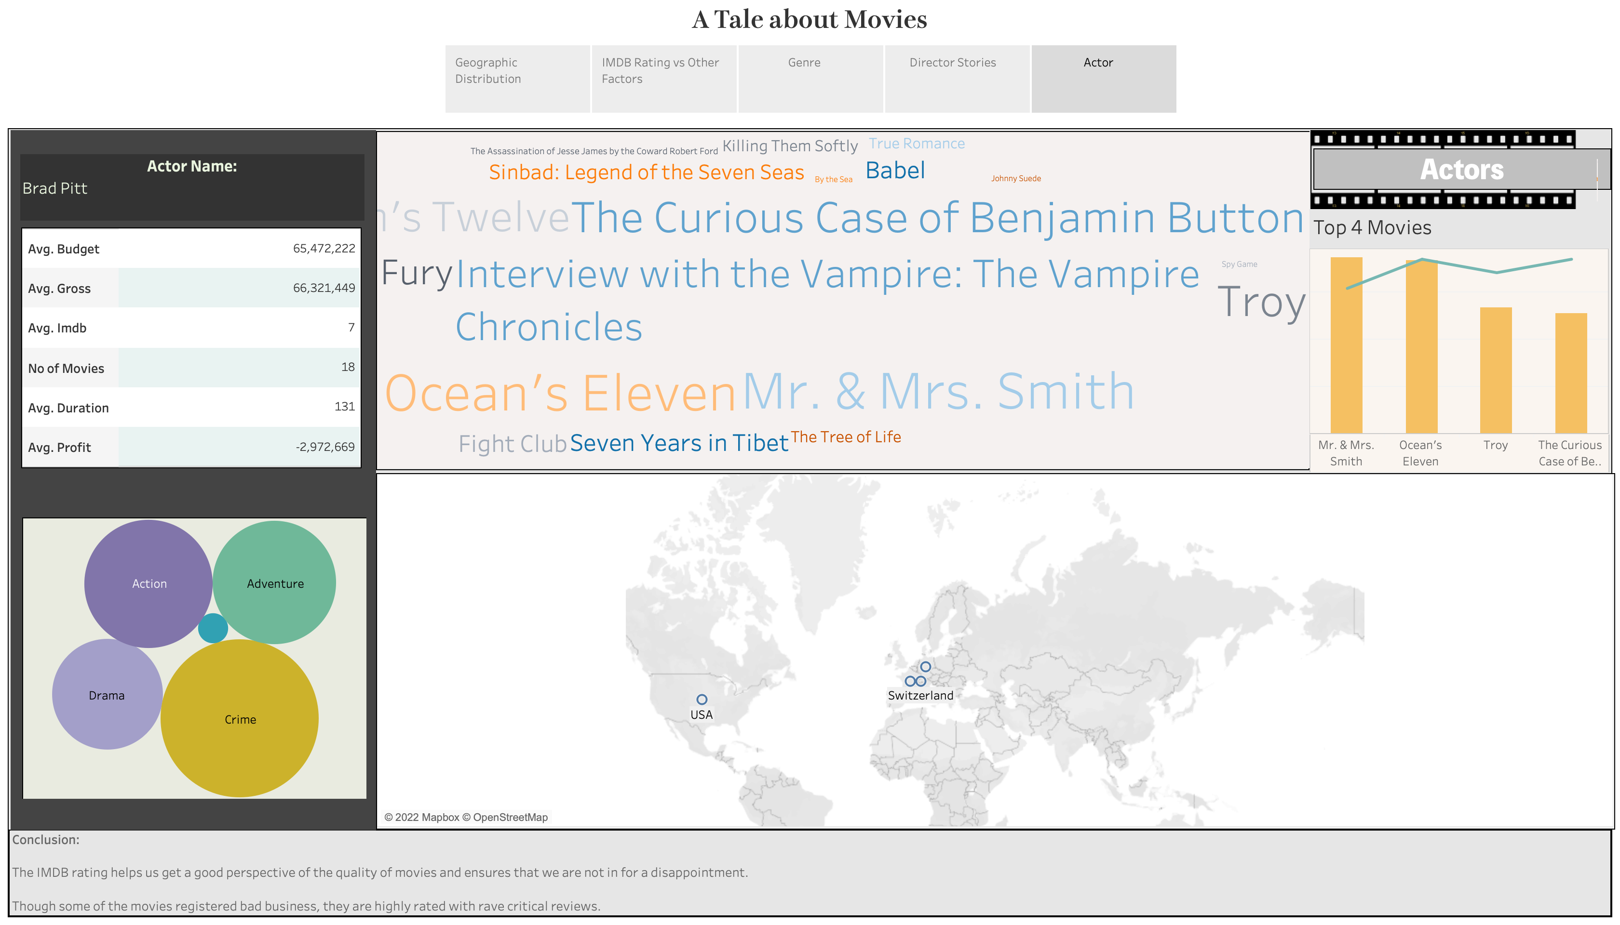

Slide 14


